Slide 1

Explainable Machine Learning for Governance-Driven Enterprise Risk Management (ERM)
Md Maksudul Amin · Anand Kumar Vedantham · Didarul Alam · Anokh Kishore
Notes:
“Good morning everyone,
I am anand, and today I will present our research on
Explainable Machine Learning for Governance-Driven Enterprise Risk Management.
This work focuses on improving enterprise risk prediction using explainable AI techniques for better governance and decision-making.”

Slide 2
Overview
Abstract
Enterprise Risk Management (ERM) is critical for organisational stability, yet traditional approaches rely on fixed indicators and manual analysis — failing to capture temporal and complex non-linear patterns in financial data.
The Problem
Proposed Model: Botfip-LLM
Key Outcome
Static, rule-based ERM methods lack adaptability and explainability in dynamic risk environments.
Delivers governance-aligned, real-time risk scores with explainable insights for enterprise decision-making.
Integrates ESCO (Enhanced Swarm Coyote Optimisation) and DRQL (Deep Recurrent Q-Learning) for accurate, interpretable risk prediction.
Notes:
“Enterprise Risk Management, or ERM, plays a critical role in ensuring organizational stability and reducing financial and operational risks.
However, traditional ERM approaches rely on fixed indicators and manual analysis, which limits their ability to detect complex and temporal patterns.
To address this, we propose a framework called Botfip-LLM, which integrates:
Large Language Models for data alignment
ESCO for feature selection
DRQL for risk prediction
This framework provides both high predictive accuracy and interpretability, making it suitable for governance-based decision-making.”

Slide 3

Problem Statement
Limitations of Traditional ERM
Core Challenges
Rely on linear models and fixed risk indicators
Cannot handle dynamic, non-linear risk relationships
Manual analysis fails at scale and speed
Heterogeneous financial, demographic, and behavioural data
Missing values and class imbalance
Lack of explainability in ML-based models
Research Gap: There is a pressing need for a real-time, explainable risk prediction system aligned with enterprise governance requirements.
Notes:
“The main issue with traditional ERM systems is that they use linear models and static indicators.
These systems fail to capture:
Dynamic and non-linear risk patterns
Temporal dependencies in financial data
Other challenges include:
Heterogeneous data sources
Missing values and class imbalance
Lack of explainability in machine learning models
Therefore, there is a strong need for a real-time, explainable, and data-driven ERM system.”

Slide 4
Research Objectives
What This Study Sets Out to Achieve
01
02
03
Governance-Driven Framework
Heterogeneous Data Alignment
Predictive Accuracy
Boost accuracy through swarm-based feature optimisation using ESCO.
Develop an ERM framework explicitly aligned with enterprise governance principles.
Leverage large language models (LLM) to unify disparate financial and behavioural data sources.
04
05
Temporal Modelling
Explainability
Capture sequential dependencies in time-series financial data via DRQL.
Provide interpretable risk insights that support transparent governance decision-making.
Notes:
“The objectives of this research are:
To develop a governance-driven ERM framework
To align heterogeneous financial, demographic, and behavioral data
To improve prediction accuracy using optimization techniques
To capture temporal dependencies in enterprise data
And to provide interpretable insights for decision-making”

Slide 5
Data
Dataset & Preprocessing
Financial Risk Assessment Dataset (Kaggle)
10K+
20+
80/20
Records
Features
Train/Test Split
Feature Categories
Demographics: Age, Education, Employment status
Income/Expense: Income levels, Debt ratios
Credit Metrics: Credit score, Loan history
Behavioural: Default history, Account activity
Preprocessing Steps
Median imputation for numerical missing values
Mode imputation for categorical missing values
SMOTE applied to address class imbalance
Notes:
“We used the Financial Risk Assessment Dataset from Kaggle.
This dataset contains:
More than 10,000 records
More than 20 features
The features include:
Demographic data such as age and employment
Financial data such as income and debt
Credit metrics like credit score
Behavioral data like payment history
For preprocessing:
Missing values were handled using median and mode
SMOTE was used to handle class imbalance
Data was split into 80% training and 20% testing
This ensures reliable and balanced data for modeling.”

Slide 6
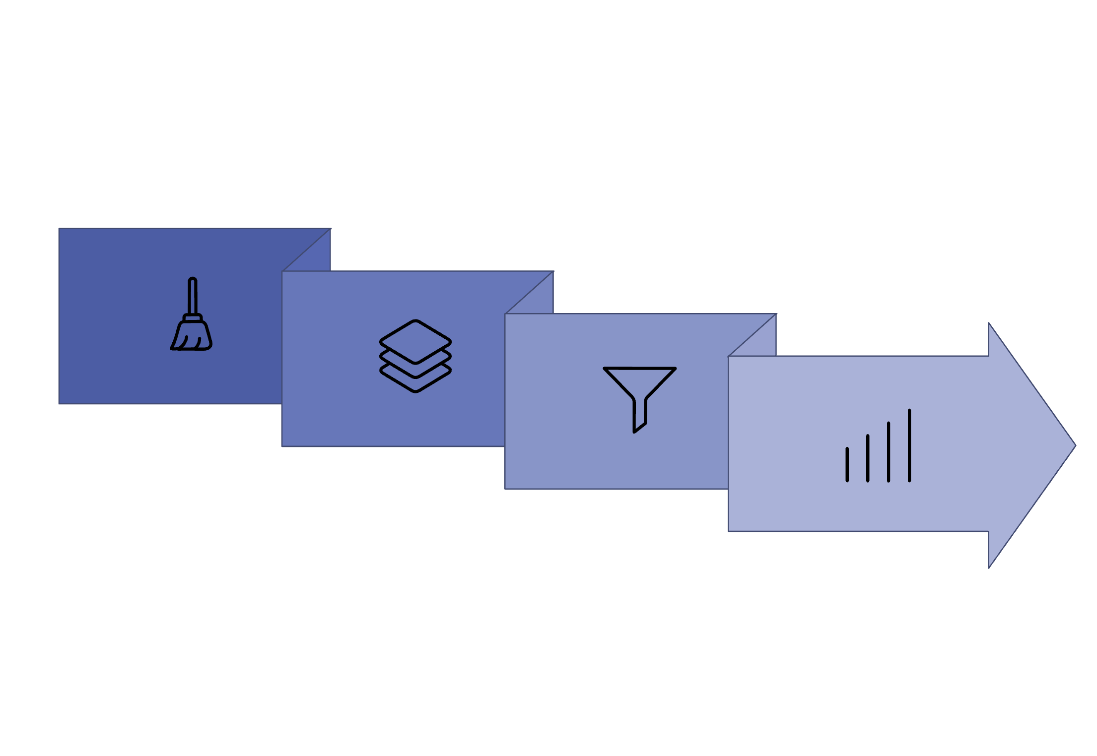




Architecture
Proposed Framework
Botfip-LLM
DRQL
Preprocess
ESCO
The Botfip-LLM backbone unifies heterogeneous inputs before ESCO selects the most discriminative features. DRQL then models sequential dependencies to generate calibrated risk scores and actionable early warning signals.
Notes:
“Our proposed framework consists of four major components:
First, data preprocessing is performed.
Then, Botfip-LLM aligns heterogeneous data using knowledge distillation from large language models.
Next, ESCO algorithm selects the most relevant features, reducing redundancy and improving efficiency.
Finally, DRQL model predicts enterprise risk by capturing time-dependent patterns.
The system outputs:
Risk scores
Early warning signals
These outputs help stakeholders make informed governance decisions.”

Slide 7
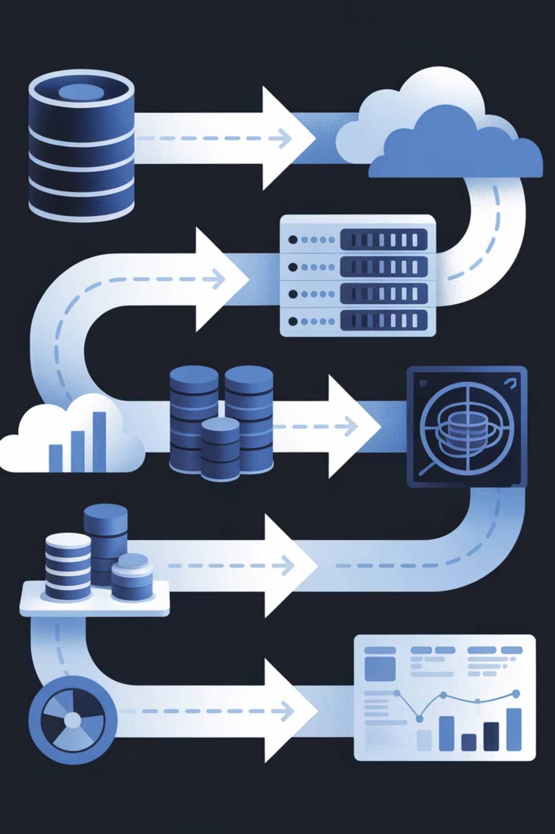




Methodology
Step-by-Step Approach
Step 1
Data Preprocessing: cleaning, normalisation, and encoding
Step 2
Data alignment via Botfip-LLM knowledge distillation
Step 3
Optimal feature selection using the ESCO algorithm
Step 4
DRQL captures sequential dependencies; outputs risk probabilities and severity levels

Slide 8




Experimental Setup
Implementation Environment
Evaluation Metrics
Software Stack
Hardware
Python 3.10
TensorFlow & PyTorch
Intel Xeon CPU
64 GB RAM
NVIDIA RTX 3090 GPU
Accuracy
Recall
Early Detection
AUC-ROC
Notes:
“The experiments were conducted using:
Software:
Python 3.10
TensorFlow and PyTorch
Hardware:
Intel Xeon CPU
64 GB RAM
NVIDIA RTX 3090 GPU
We evaluated performance using:
Accuracy
Recall
Early detection
AUC-ROC”

Slide 9
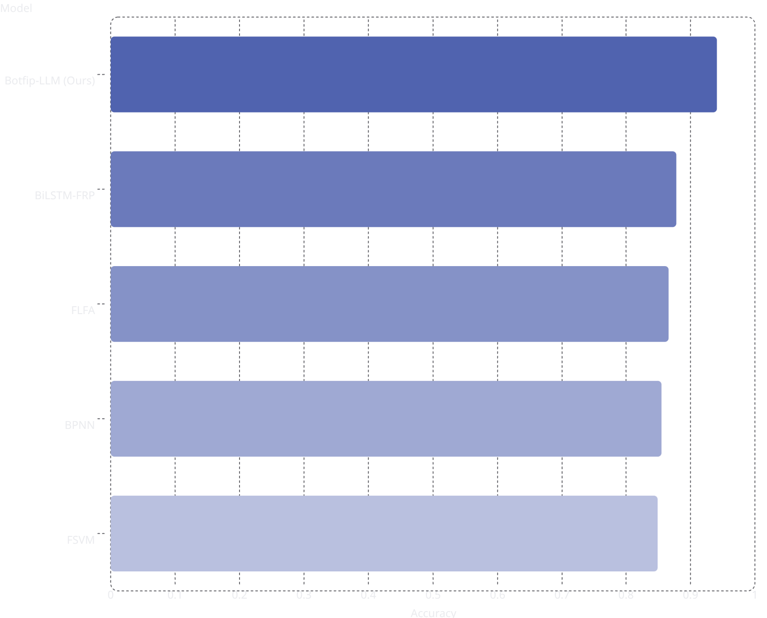
Results
Performance & Comparative Analysis
Proposed Model Metrics
0.94
Key drivers: debt-to-equity ratio and operating cash flow. Accuracy improvement of +9.2% over FSVM baseline.
0.88
0.87
0.86
Accuracy: 0.941
Recall: 0.911
Early Detection: 0.902
Financial Resilience: 0.914
0.85
AUC-ROC: 0.945
Notes:
“The results show that our model performs significantly better than existing methods.
Accuracy achieved is 0.941
Recall is 0.911
Early detection score is 0.902
Financial resilience is 0.914
AUC-ROC is around 0.945
Compared to baseline models:
Accuracy improved by up to 9.2%
Recall improved significantly
Important features identified include:
Debt-to-equity ratio
Operating cash flow
These results demonstrate both high performance and interpretability.”

Slide 10
Conclusion
The Botfip-LLM + ESCO + DRQL framework advances enterprise risk management by delivering high predictive accuracy, robust early detection, and governance-aligned explainability.
Framework Strengths
Application Domains
State-of-the-art accuracy (AUC-ROC: 0.945)
Interpretable insights for regulatory compliance
Real-time temporal modelling via DRQL
Lending and credit risk systems
Investment portfolio analysis
FinTech risk governance platforms
References (IEEE): [1] Tan & Lee, J. Accounting & Org. Change, 2021. [2] Ahmad et al., Procedia SBS, vol. 164, 2014. [3] Khan et al., Management Decision, vol. 54, 2016. [4] Han & Laing, Int. Rev. Econ. Finance, vol. 103, 2025. [5] Chen, Discover AI, vol. 5, 2025.
Notes:
“To conclude,
We proposed an explainable machine learning framework combining:
Botfip-LLM
ESCO
DRQL
This framework provides:
High prediction accuracy
Better early risk detection
Interpretable insights for governance
It outperforms traditional and deep learning models and is suitable for:
Financial systems
Lending platforms
FinTech applications
Thank you.

